Slide 1
Cultural Heritage and Sustainable Development
An Educator’s Handbook
MODULE 3
Space, Place and Cultural Heritage
SESSION 3
Cultural Heritage and Place Branding for Local & Regional Development
This presentation is part of the InHeriT project:
This project has been funded with support from the European Commission. This publication reflects the views only of the authors, and the Commission cannot be held responsible for any use, which may
be made of the information contained therein.
ERASMUS+
KA2 STRATEGIC PARTNERSHIP ADULT EDUCATION
PROJECT NO. 2015-1-EL01-KA204-014085
Prepared by:
Costas Priporas,
Senior Lecturer in Marketing,
Business School, Middlesex University London
Notes:
In this presentation we discuss the concept of place branding and how it is connected with the cultural heritage of a place in an effort to design and implement a strategy for local and regional development. The presentation aims to equip participants with an understanding and knowledge of what is a place branding and how the local/regional cultural heritage can be used as a central theme in designing a place branding.

Slide 2
T.1
Objectives
Develop the participants understanding on place branding
Provide the participants with an overview of the links between cultural heritage and place branding
Develop the participants understanding on the role of cultural heritage in place branding
Develop the participants understanding of how different places utilize their local cultural heritage in their branding strategies
Notes:
Here is an outline of the topics for this module

Slide 3
T.1
Learning Outcomes
Identify and discuss various aspects of place branding and cultural heritage
Explain how places utilize the local cultural heritage in their branding strategies
Explain the importance of cultural heritage as a key strategic feature in place branding
Explain the role of residents in place branding
Notes:
At the end of this presentation, participants will be able to explain the concept of place branding, the relationship of cultural heritage and place branding and to design a branding strategy based on the local cultural heritage for local/regional development.

Slide 4
T.1
What is a brand and branding
A brand is a name, sign, symbol ,logo, or combination of them
It is set of associations that are linked to a product range, a division, or company.
Branding is an effort to give a unique identity to the company’s products and create emotional associations with consumers.
Notes:
Brand can be defined in many ways . For example, coca cola, Mercedes, New York, are brands. Brands create associations (images ) to consumers’ minds. Consumers expect top brands (i.e. Armani clothes) to have a superior quality given their high retail price.

Slide 5
T.2
Place Background
Place= a city, a destination-resort, region, a nation
Competition among places is intense
Places try to attract investments, tourists and corporate presence
Places must pay more attention to building and promoting their brand
Changing global environment (SM, technology, consumers)
Unbalanced economic development
Notes:
Places are diverse and complex in nature as they include many stakeholders and economic sectors. A place is an amalgam of products and services and each place needs its own visions and solutions to be successful. A place must be competitive in comparison with other places in order to retain and enhance resources and to attract visitors.

Slide 6
T.2
What is branding
https://www.youtube.com/watch?v=JKIAOZZritk&t=101s
Notes:
A video that explains what is a brand and branding
Ask participants to provide their undersatnding

Slide 7
T.2
Place Branding
Based on literature (Anholt, 2010; Kavaratzis, 2005) Zhao et al. (20017, p. 2) defined place branding “as a process of forming a series of unique associations with the place through presenting the functions, emotions, relationships, and strategic elements to the public”
Within the context of the experience economy, place branding can be understood as the “aesthetication of place,” or the development of an overall narrative about what it means to be there, to experience the place and what constitutes the staging of that experience” (Richards, 2017)
Notes:
Place Branding is relative new phenomenon.
Branding is the process in creating a unique name and image for a product and service in the consumer’s mind. Branding involves creating mental structures and helping consumers organize their knowledge about products and services in a way that clarifies their decision making and, in the process, provides value to the place (city, region, country).

Slide 8
T.2
Place branding & competitive advantage
Kotler (1999) describes four distinct areas as the basis for establishing a competitive advantage in place branding:
Design (character)
Infrastructure (fixed environment)
Basic services (service provider) &
Attractions (entertainment & recreation)
Notes:
To establish a competitive advantage a place must focus on the elements that differentiate it form others. Design (the place as character , what is unique). How satisfactory is the infrastructure (transportation, developments). Basic services (hotels for all types of visitors). Some places are famous for their nightlife.

Slide 9
T.2
The influence of a place-brand
Increases attractiveness of companies & investments
Promotes the objectives of the tourism industry
Promotes public diplomacy
Supports the interests of the exporting industry
Strengthens citizens’ identity and increases self-esteem (Moilanen & Rainisto, 2009).
Notes:
Well known places have developed a brand image and attract resources and visitors.
Place branding brings wealth

Slide 10
T.1
The role of residents
Residents, as brand community co-creators (Braun et al., 2013), can participate in the city’s (place ) promotional campaign (Florek, 2011).
Residents act as ambassadors for the place (Braun et al., 2013; Zenker et al., 2017).
Residents are not only the most significant target audience of city branding, but also the most significant marketers of a city (Kavaratzis, 2004).
Notes:
Residents have very important role in place branding formation since they can be the ambassadors for the place. For example, in 2007 New York City authorities, in an effort to encourage New York residents to welcome visitors and share with them their knowledge on various activities (i.e., late night eats, liveliest flea markets), launched a campaign named ‘Just Ask the Locals’ by featuring celebrity residents such as Robert de Niro, Julian Moore, Kevin Bacon and Sean Diddly Combs

Slide 11
T.1
Place branding: The power of place
https://www.youtube.com/watch?v=-_7DHvr-3Jc
Notes:
A video that provides an expert’s view o place branding.
Ask participants to provide their views.

Slide 12
T.2
Cultural heritage & place branding
Historical and cultural heritage is an integral part of place identity, infrastructure and landscape
Cultural heritage often incorporates traditional and cultural values of certain regions, including beliefs, ideas, traditions and foods.
Branding through cultural heritage requires exploration of local cultural features of the place, identifying what features are prominent there, as well as finding ways to explicate and enhance those features (Fan , 2014)
Notes:
Cultural heritage is a multidisciplinary theme. Park (2014: 22) identified heritage ‘as both a tangible and intangible outcome of the past inherited from one generation to the next’. According to Park (2014) a variety of heritage attractions and events, including recent recreations of the past driven by the process of commodification, are an essential part of heritage supply.
Cultural tourism is an important segment in tourism industry. Heritage tourism can be seen as a part of cultural tourism. Culture is a powerful differentiation for any place. Many places around the world try to promote their heritage sites in order to attract more tourists and generate income for the locals

Slide 13
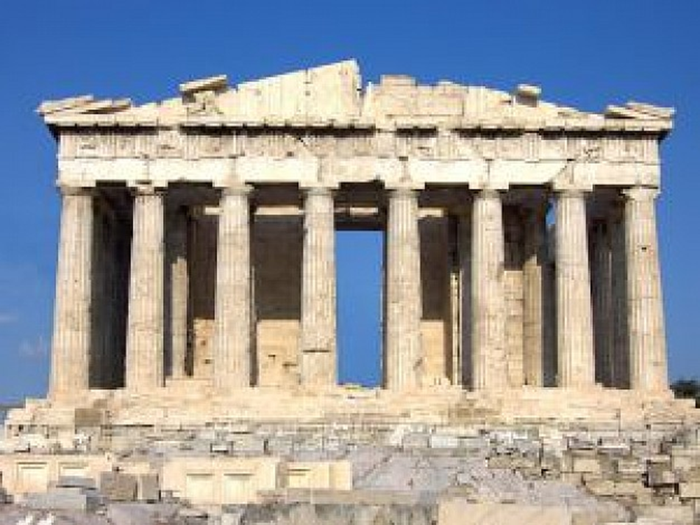
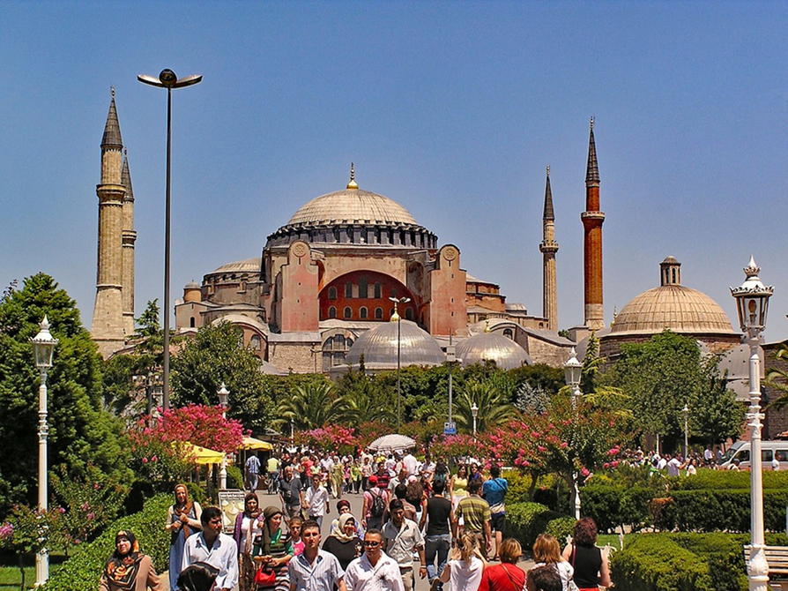
T.2
Notes:
World heritage cultural sites.
Ask participants to observe the photos and describe them in terms of cultural heritage and to link them with palce branding .

Slide 14
T.2
Place branding strategy
Define the objective and of the place branding strategy (i.e. create a certain image, change a negative image, repositioning, etc)
Collaboration between private and public sectors
Proper coordination
Involve residents (domestic audience)
Use proper communication channels and message for each target group
Notes:
A place’s brand to a large extent is shaped by its history, culture, heritage, location, customs, achievements of its citizens and vision of its leaders . The place branding strategy is about planning, improving, developing and communicating the offer and experience ,and thus all the stakeholders must participate in this common effort.

Slide 15
T.3
Case 1 (Franch et al., 2017)
War heritage sites are part of the broader cultural heritage
Cultural tourism in Trentino (Italy), is growing in importance, particularly following recent public investment which has seen the creation of important museums (i.e. the Science Museum in Trento), and the reclamation of numerous artifacts and sites related to the Great War.
Area’s significance in the First World War (WWI)
Notes:
This case describes how a place takes advantage of its war heritage in order to attract visitors.

Slide 16
T.3
Case 1
In 2009, the Province of Trento founded the Trentino Great War Network, this network involving public institutions aims valorise Trentino’s war heritage
The restoration and valorisation of Trentino’s war heritage has been funded by the EU (LEADER II), the public institution of the province and a local foundation

Slide 17
T.3
Case 1
Some of the forts in Trentino have been completely rebuilt and valorised as tourism products.
They provide museum space, put on exhibitions, organize events and even offer catering.
The municipalities responsible for the forts ensure that they are well sign posted.
Museums, members of the Trentino Great War Network, have been created in some of the forts visited during fieldwork. The information they provide, on and offline, is available in Italian, German and English
Result
A continued and growing interest by tourists

Slide 18
T.3
Case 1
In 2009, the Province of Trento founded the Trentino Great War Network, this network involving public institutions aims valorise Trentino’s war heritage
The restoration and valorisation of Trentino’s war heritage has been funded by the EU (LEADER II), the public institution of the province and a local foundation

Slide 19
A.1
Activity
Please discuss cultural heritage features of your place that could be utilized and design a place branding strategy, taking into consideration the role of residents and potential visitors
Notes:
Participants can design a place branding strategy around their local cultural heritage.
You seek individual answers.

Slide 20
A.2
Activity
Discuss and answers questions
Notes:
Summarize the key points . Ask participants if they have any questions regarding the presentation and activity 1
and provide possible answers.

Slide 21
A.2
References
Anholt, S. (2010). Definitions of place branding: Working towards a resolution. Place Branding and Public Diplomacy, 6(1), 1–10.
Braun, E., Kavaratzis, M. & Zenker, S. (2013). My city–my brand: The different roles of residents in place branding. Journal of Place Management and Development, 6(1), 18–28.
Fan, H. (2014). Branding a place through its historical and cultural heritage: The branding project of Tofu Village in China. Place Branding and Public Diplomacy, 10(4), 279-287.
Florek, M. (2011). No place like home: Perspectives on place attachment and impacts on city management. Journal of Town & City Management, 1(4), 346-354.
Franch, M., Irimiás, A., & Buffa, F. (2017). Place identity and war heritage: managerial challenges in tourism development in Trentino and Alto Adige/Südtirol. Place Branding and Public Diplomacy, 13(2), 119-135.
Kavaratzis, M. (2005). Place branding: A review of trends and conceptual models. The Marketing Review, 5(4), 329–342.

Slide 22
A.2
References
Kavaratzis, M. (2004). From city marketing to city branding: towards a theoretical framework for developing city brands. Journal of Place Branding and Public Diplomacy, 1(1), 58-73.
Kotler, P. (1999). Marketing Places Europe. 1st ed. London: Financial Times Prentice Hall.
Moilanen, T., & Rainisto, S. (2009). How to Brand Nations, Cities and Destinations. A Planning Book for Place Branding. Houndmills, UK: Palgrave MacMillan.
Richards, G. (2017). From Place Branding to Placemaking: The role of events. International Journal of Event and Festival Management, 8(1), 8-23.
Zenker, S., Braun, E., & Petersen, S. (2017). Branding the destination versus the place: The effects of brand complexity and identification for residents and visitors. Tourism Management, 58, 15-27.
Zhao, W., Sun, R., & Kakuda, N. (2017). Institutionalized place branding strategy, interfirm trust, and place branding performance: Evidence from China. Journal of Business Research, 78, 261-267

Slide 23
A.2
THANK YOU FOR YOUR TIME

